Slide 1

Time Series Analytics
…an introduction
University of Colorado – Boulder, Stat 5010 Study
Pranjal Pathak, Akhilesh Patil, Nikhil Belavinakodige, Prasenjeet Gadhe

Slide 2



Motivation
Exactly! We're interested in forecasting sales for our Longmont Store, but due to the recent layoffs, we messed up!
WE FIRED THE WRONG PEOPLE !!
Hello, Buffs! We heard that you just finished a course in Regression, and you learned a lot from Dr. O?
OH! That’s new. Sure, we would be happy to help! Send us some of your historic data, and we’ll work on a POC.
If you’re happy, we can move forward!
Well Duh! Yeah we did. Why do you ask - do you have a cool project for us?

Slide 3
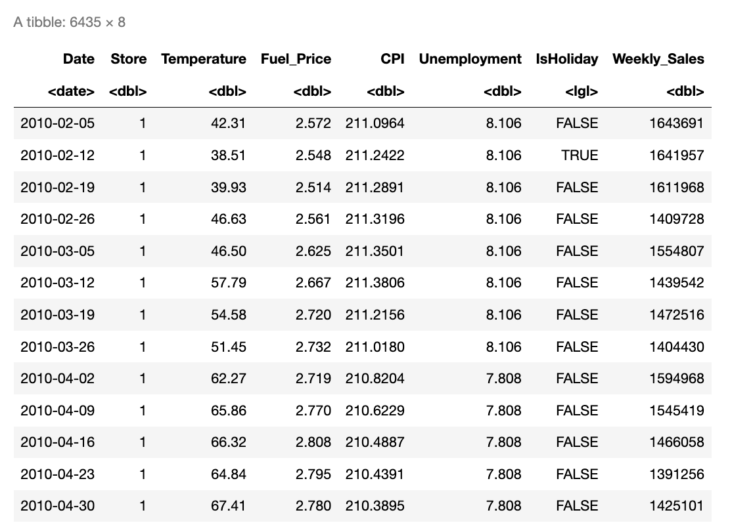
POC Dataset
Historic Dataset: Feb 2010 - Oct 2012 6000 Records
Forecast: 10 Weeks (Oct 2012 ~ Jan 2013)
~
Y
X
Weekly_Sales
Timestamp

Slide 4
Time Series Introduction
Time Series Analysis allows to enhance comprehension and predictions on any quantitative variable of interest (sales, resources, financial KPIs, logistics, sensors’ measurements, logistics, inventory planning, etc.), using either one or multiple variables. For a given timestamp and set of variables, we wish to predict (forecast) a Target for future dates.
Time Series Forecast Strategies
Forecasting using only one Target variable
Forecasting using Target & other variables
Timestamp (X) | Sales (Y)
March 2023 | 5 Million
April 2023 | 3 Million
May 2023 | ?
June 2023 | ?
The simplest time series forecasting methods use only information on the variable to be forecast, and make no attempt to discover the factors that affect its behaviour. Therefore they will extrapolate trend and seasonal patterns, but they ignore all other information.
Techniques:
Decomposition (Moving Averages)
Exponential smoothing
ARIMA
Seasonal ARIMA
Timestamp (X1) | Is Holiday (X2) | Sales (Y)
03 / 01 / 2023 | FALSE | 5 M
03 / 02 / 2023 | TRUE | 5.2 M
… | … | …
06 / 01 / 2023 | TRUE | ?
The advanced forecasting methods use other variables which affect the Target variable and help in forecasting..
Techniques:
Dynamic Regression
Longitudinal Modelling
Hierarchical Networks
Neural Networks (LSTM)

Slide 5
Time Series Introduction
Sample Time Series Data
←—--- KNOWN —--→
Timestamp | Temperature | Weather | Sales (M)
2023-04-01 | 22 * C | Rain | 0.40
2023-04-02 | - 4 * C | Snow | 0.29
 | …
2023-04-30 | 10 * C | Sunny | 1.02
FORECAST
Sales (Millions)
Using
one OR
many
predictors
04-01 04-10 04-18 04-25 04-30 05-01
Time Stamp (2023)

Slide 6
Time Series Forecasting Pipeline
STEP 1: Collect Continuous Time-Series Data (Daily, Weekly, etc)
STEP 2: Preprocess Dataset (Missing Values, Scaling, Convert to TS-Object, etc)
STEP 3: Decomposition of Time-Series into Trend-Cyclic, Seasonality, Remainder
STEP 4: Detailed Analysis of Patterns, Anomalies, Impact of other predictors
STEP 5: Choose a Strategy (One Predictor, Unique-ID, Multiple Preds)
STEP 6: Forecasting: Basic prediction using decomposed components
STEP 7: Forecasting: Generic prediction using ARIMA, Regression, Double-ES, LSTMs
STEP 8: Dashboarding

Slide 7
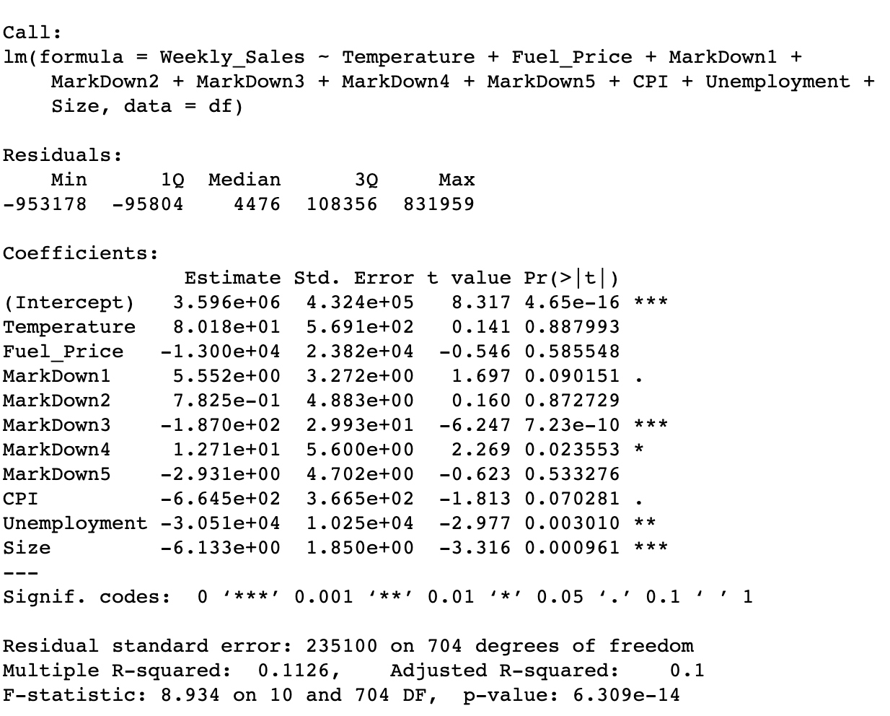
Linear Regression
We started with the basic Regression modelling just to check what is the performance of a Linear Regression Model on this dataset, and if the various assumptions hold.
R-Squared: 0.11
Adjusted R-Squared: 0.1
Extremely low parameter estimates
All assumptions violated beyond recognition!

Slide 8
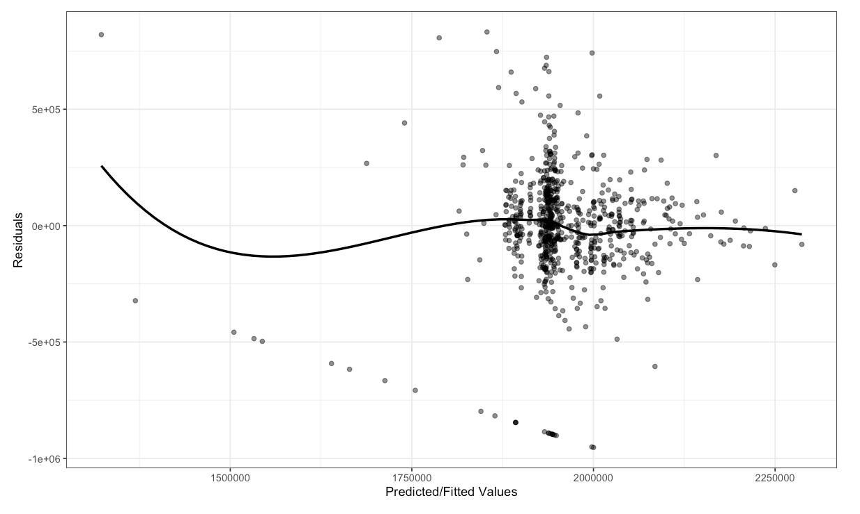
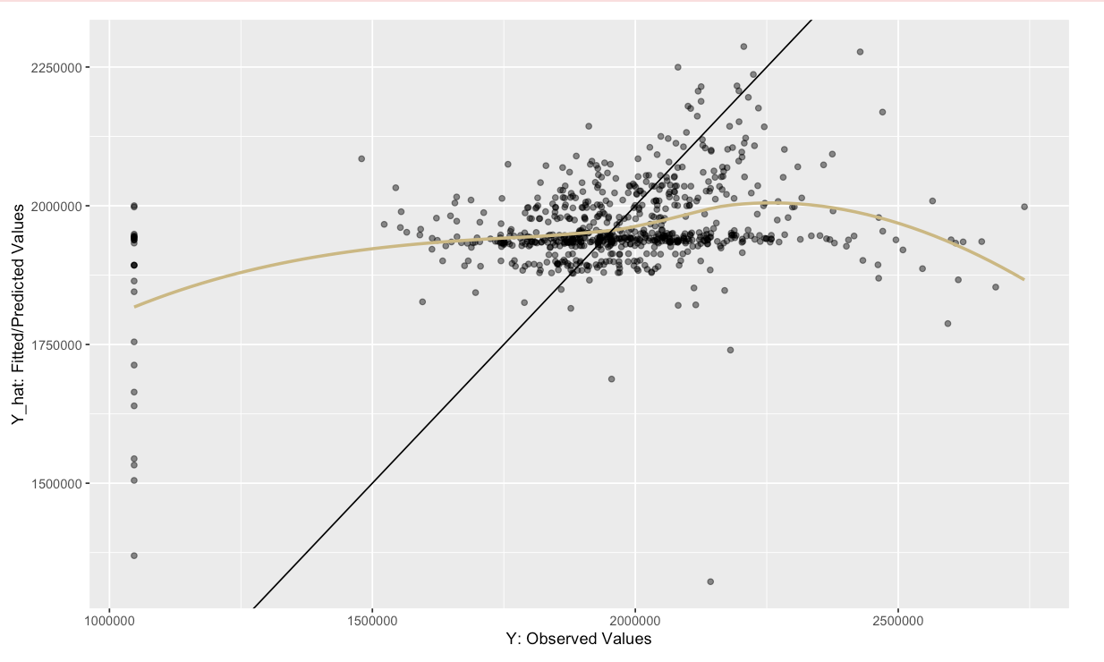
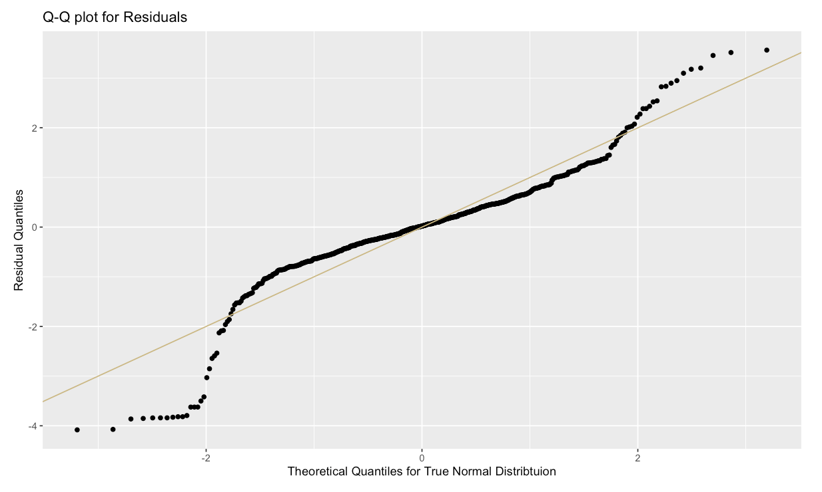
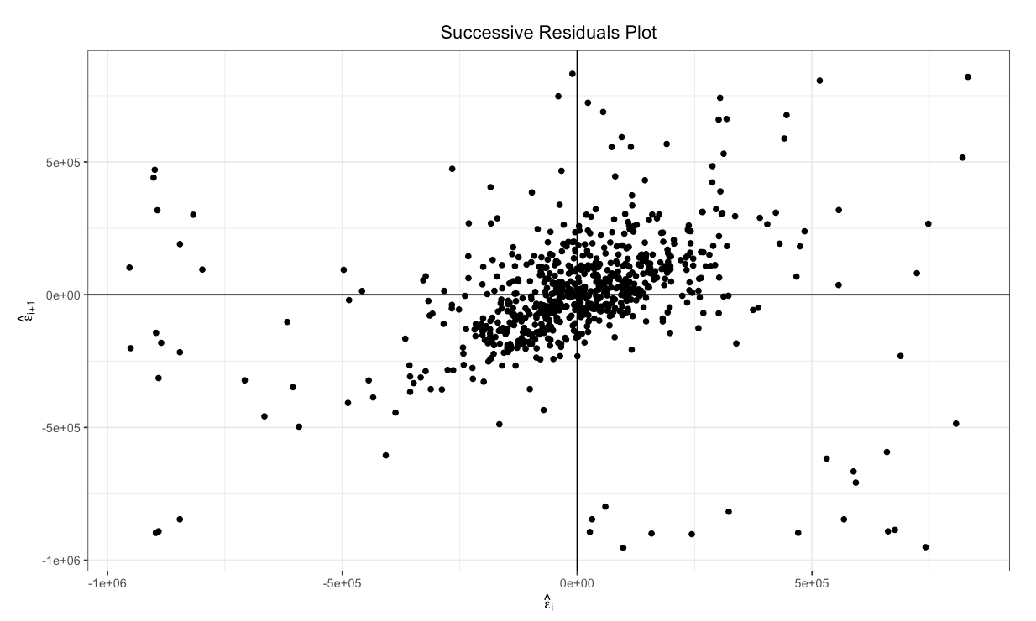
Linear Regression
Assumptions:
Linearity
Independence
Homoscedasticity
Normality
Gram Matrix Inverse
Multicollinearity
FAIL

Slide 9
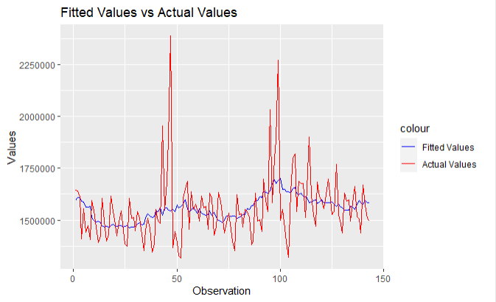
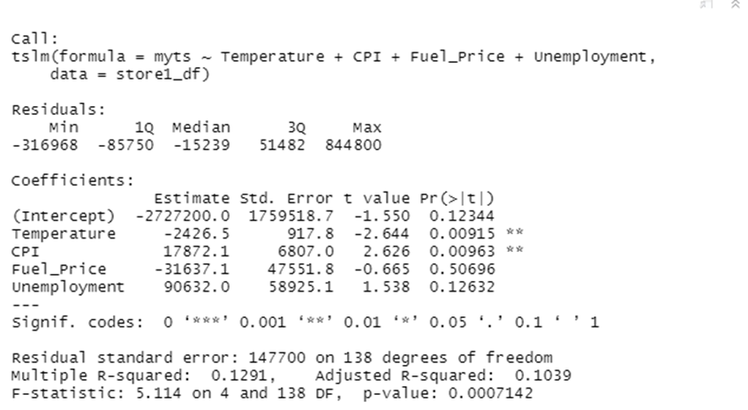
Time Series Regression
Least Squares Estimation
•The model explains approximately 13% of the variation in weekly sales (Adjusted R-squared: 0.1039)
•Temperature and CPI have a significant positive effect on weekly sales (p < 0.01)
•Fuel price and unemployment do not have a significant effect on weekly sales (p > 0.05)

Slide 10
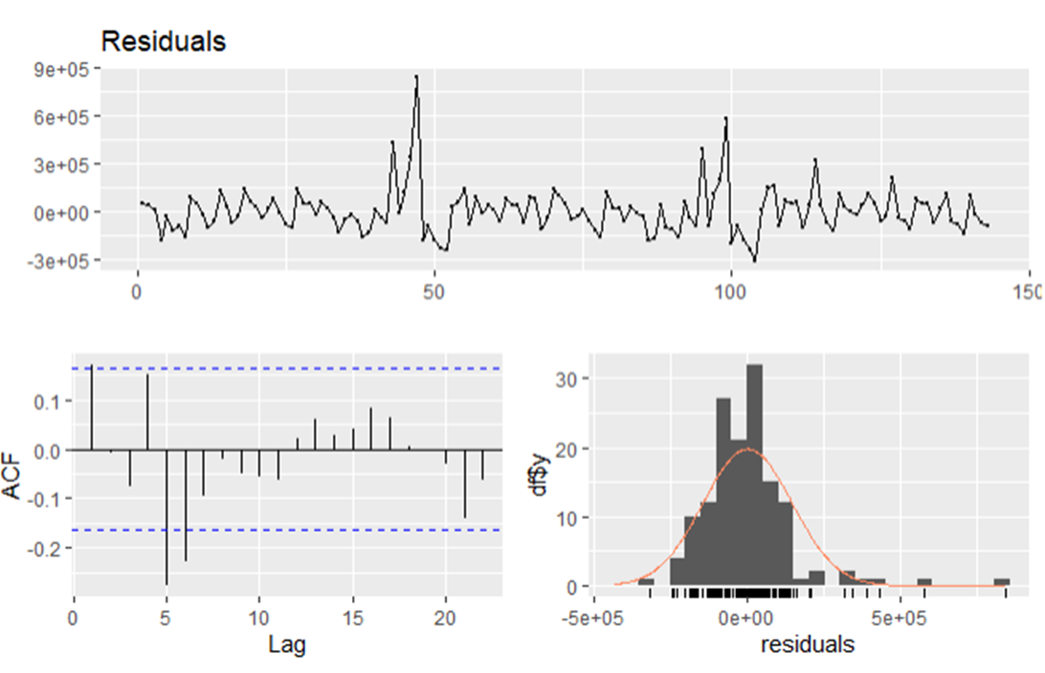
Time Series Regression
Evaluating Regression Models - Breusch-Godfrey test
•Breusch-Godfrey test checks for autocorrelation in residuals of a regression model
•Test was performed on residuals with order up to 10
•Test results show significant serial correlation up to order 10
•P-value of the test is 0.0001767, which is less than 0.05 significance level
•Null hypothesis that there is no autocorrelation in residuals is rejected
•This suggests that the regression model may not be adequately capturing all the relevant information in the data
•Modification of the model may be necessary to account for the remaining autocorrelation for more accurate and efficient forecasts.

Slide 11

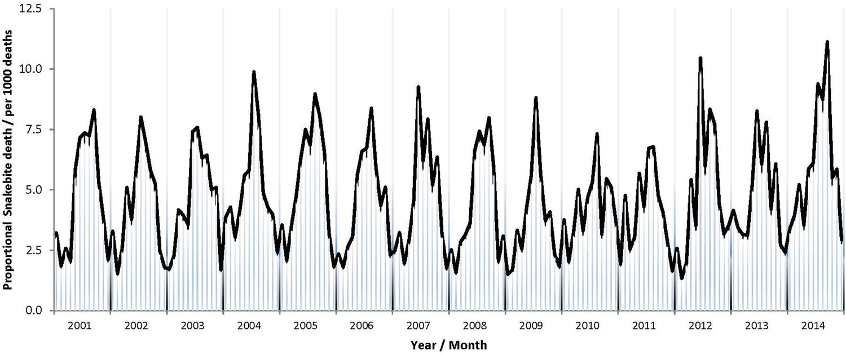
Time Series Regression
Trends and Seasonality as useful predictors
•Trend refers to the long-term movement of a time series variable over time.
•To model a trend, we can use the tslm() function in R with the trend predictor.
•Seasonality refers to the periodic fluctuation of a time series variable over time.
•A seasonal dummy variable takes a value of 1 or 0 depending on whether the observation belongs to a particular season or not.

Slide 12
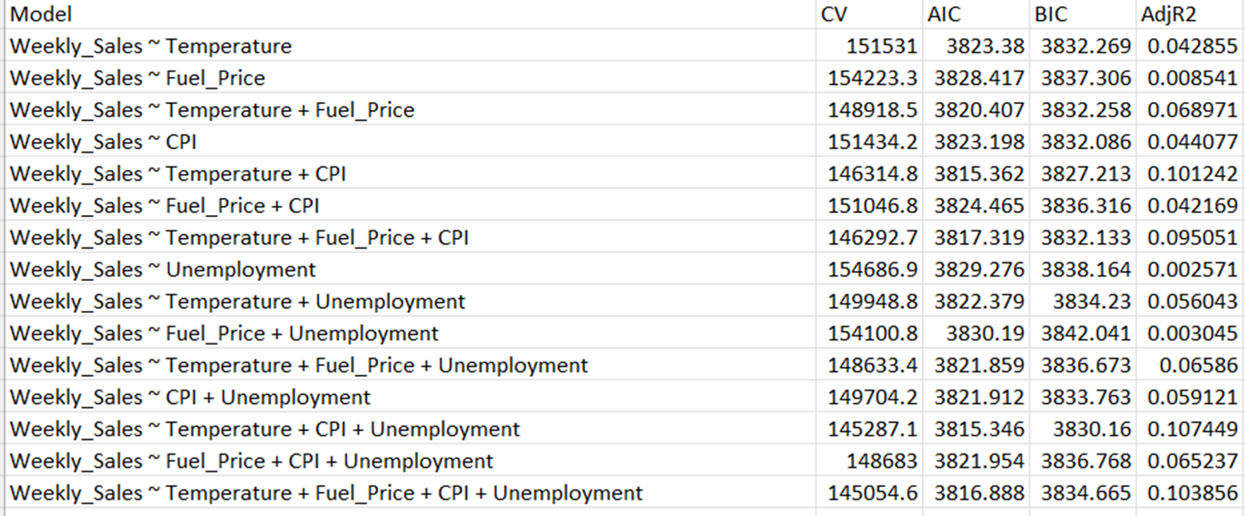
Time Series Regression -
Selecting Predictors
•Lower AIC and BIC values indicate better model fit, and higher adjusted R-squared indicates better fit.
•Including interactions between predictors did not improve the model's performance significantly.
•The best-performing model includes only the four main effects: temperature, fuel price, CPI, and unemployment.

Slide 13
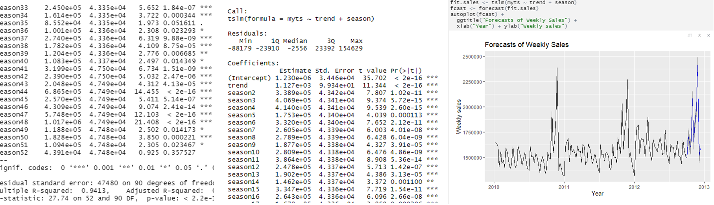
Time Series Regression - Forecasting with Regression
•The coefficients table shows the estimated intercept, trend, and seasonal coefficients
•Each seasonal dummy variable represents a month of the year (season1 is the reference level)
•All coefficients have a p-value < 0.05, indicating that they are statistically significant and have an effect on the outcome variable
•The model can be used to predict future values of the time series based on the trend and seasonal patterns

Slide 14
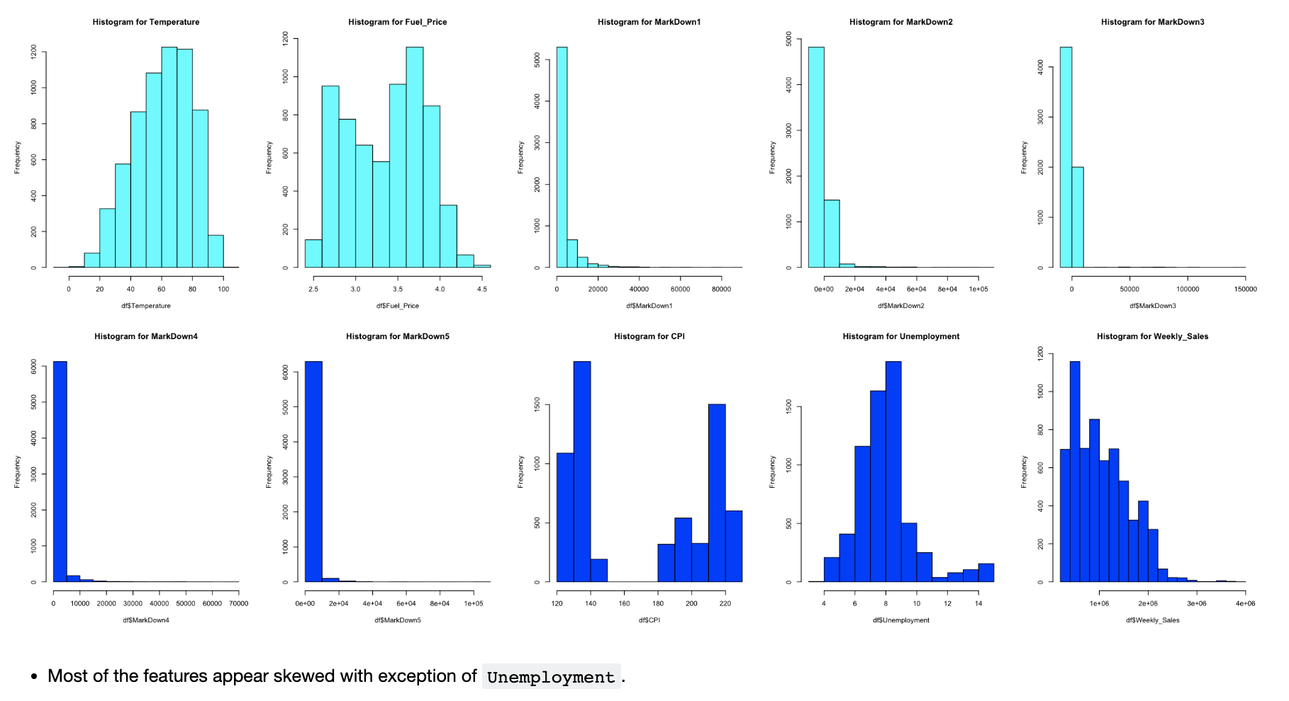
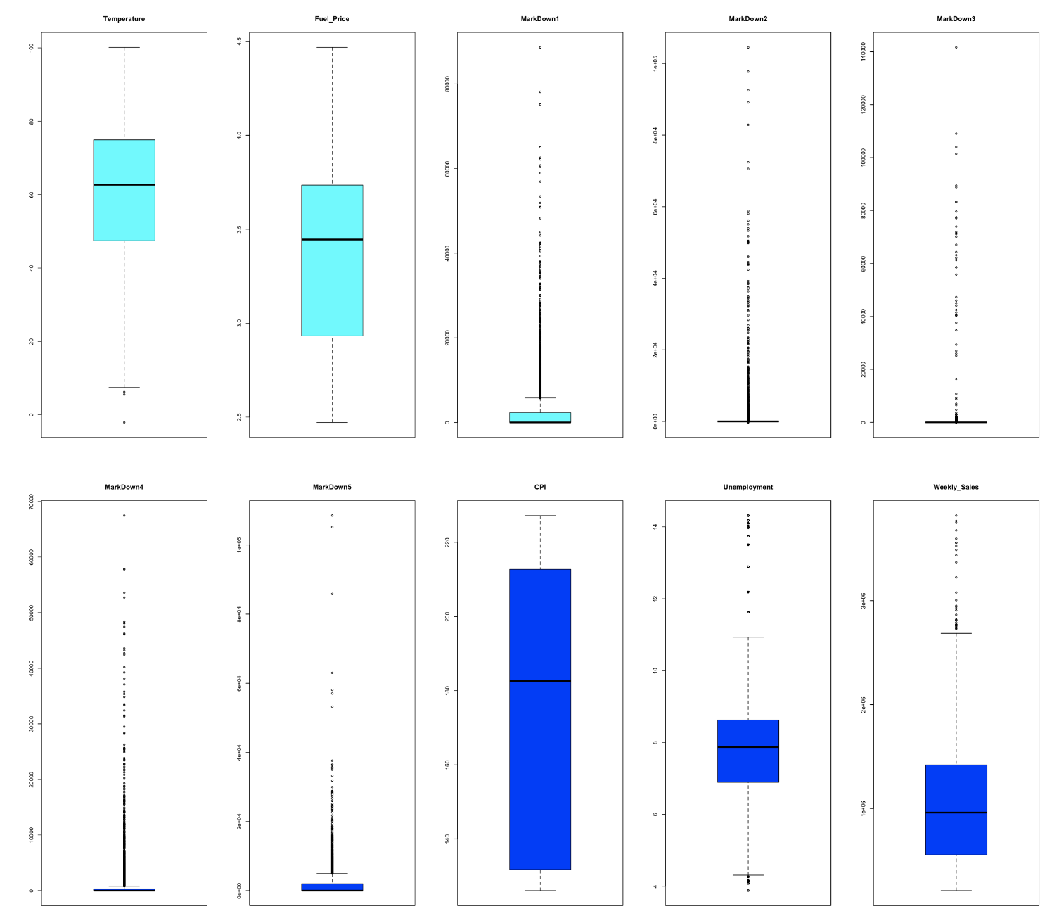
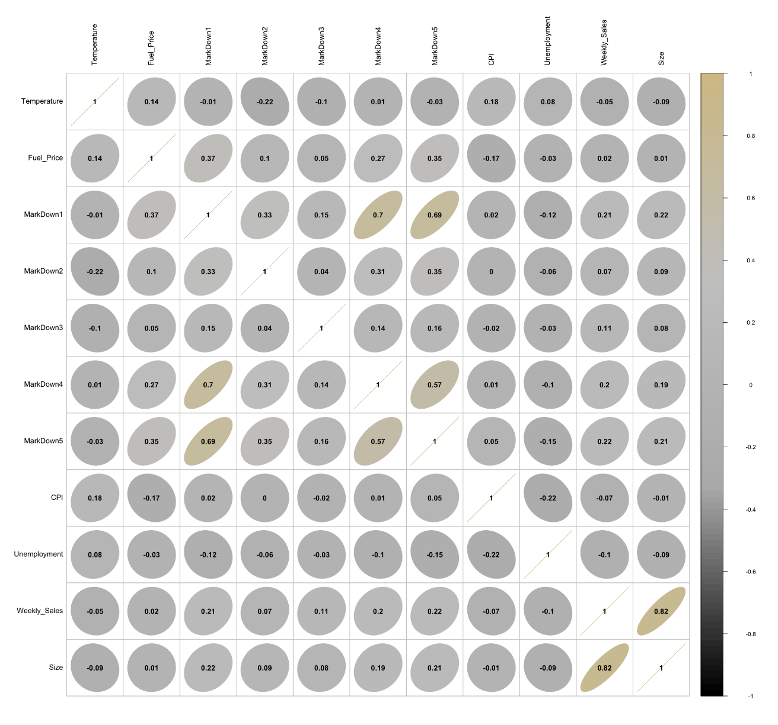
Time Series EDA
We started with the basic Regression modelling just to check what is the performance of a Linear Regression Model on this dataset, and if the various assumptions hold.

Slide 15
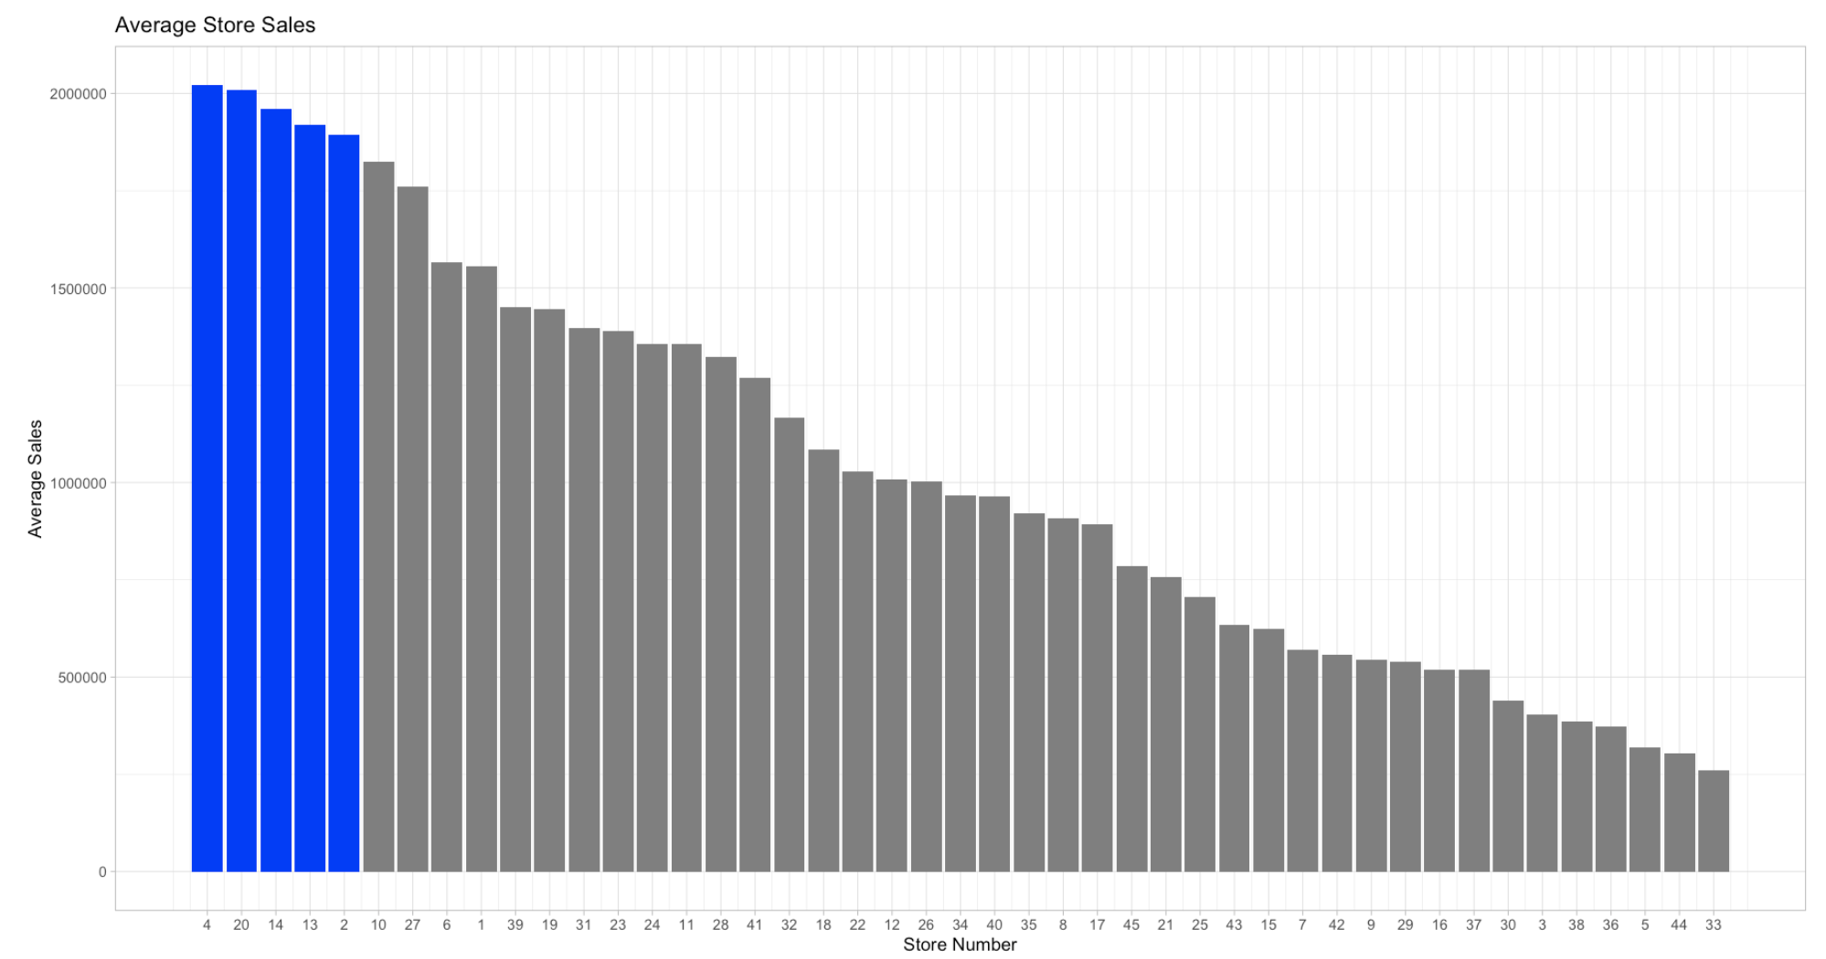
Time Series EDA
For the further study, we focussed only on the 5 locations of Walmart, that had the most weekly sales.

Slide 16
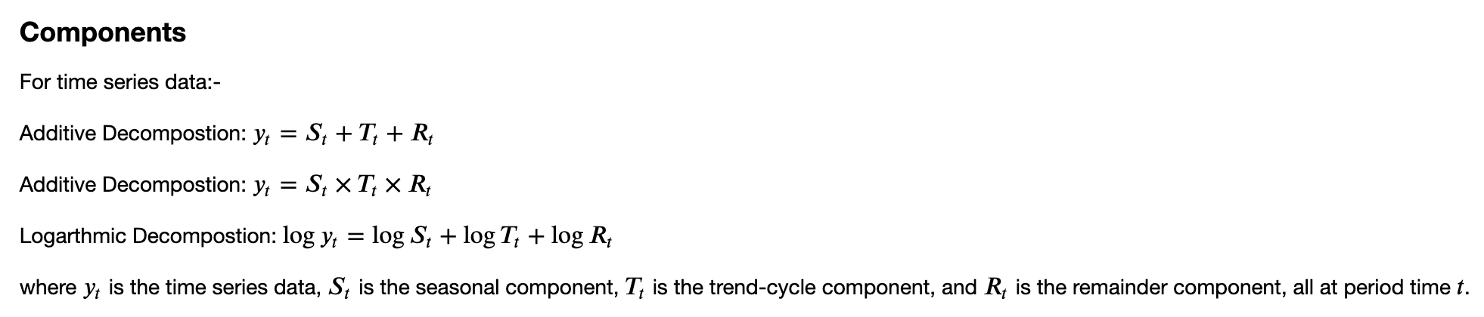
Time Series Decomposition
There are primarily ** three ** types of time-series patterns:
Trend: A trend is a long-term pattern that shows the general direction in which the data is moving over time. A trend can be linear or nonlinear, and it can change over time.
Seasonality: Seasonality refers to a pattern that repeats itself at regular intervals over time, typically within a year or less.
Cycles: Cycles refer to a pattern that repeats itself over a period of time that is longer than a year, such as every 5 or 10 years.
When we decompose a time series into components, we usually combine the trend and cycle into a single trend-cycle component (sometimes called the trend for simplicity). Thus time series comprises of three components: a trend-cycle component, a seasonal component, and a remainder component (containing anything else in the time series).

Slide 17
Decomposition But Why?
Trend Component
+
=
Seasonal Component
+
Remainder Component

Slide 18
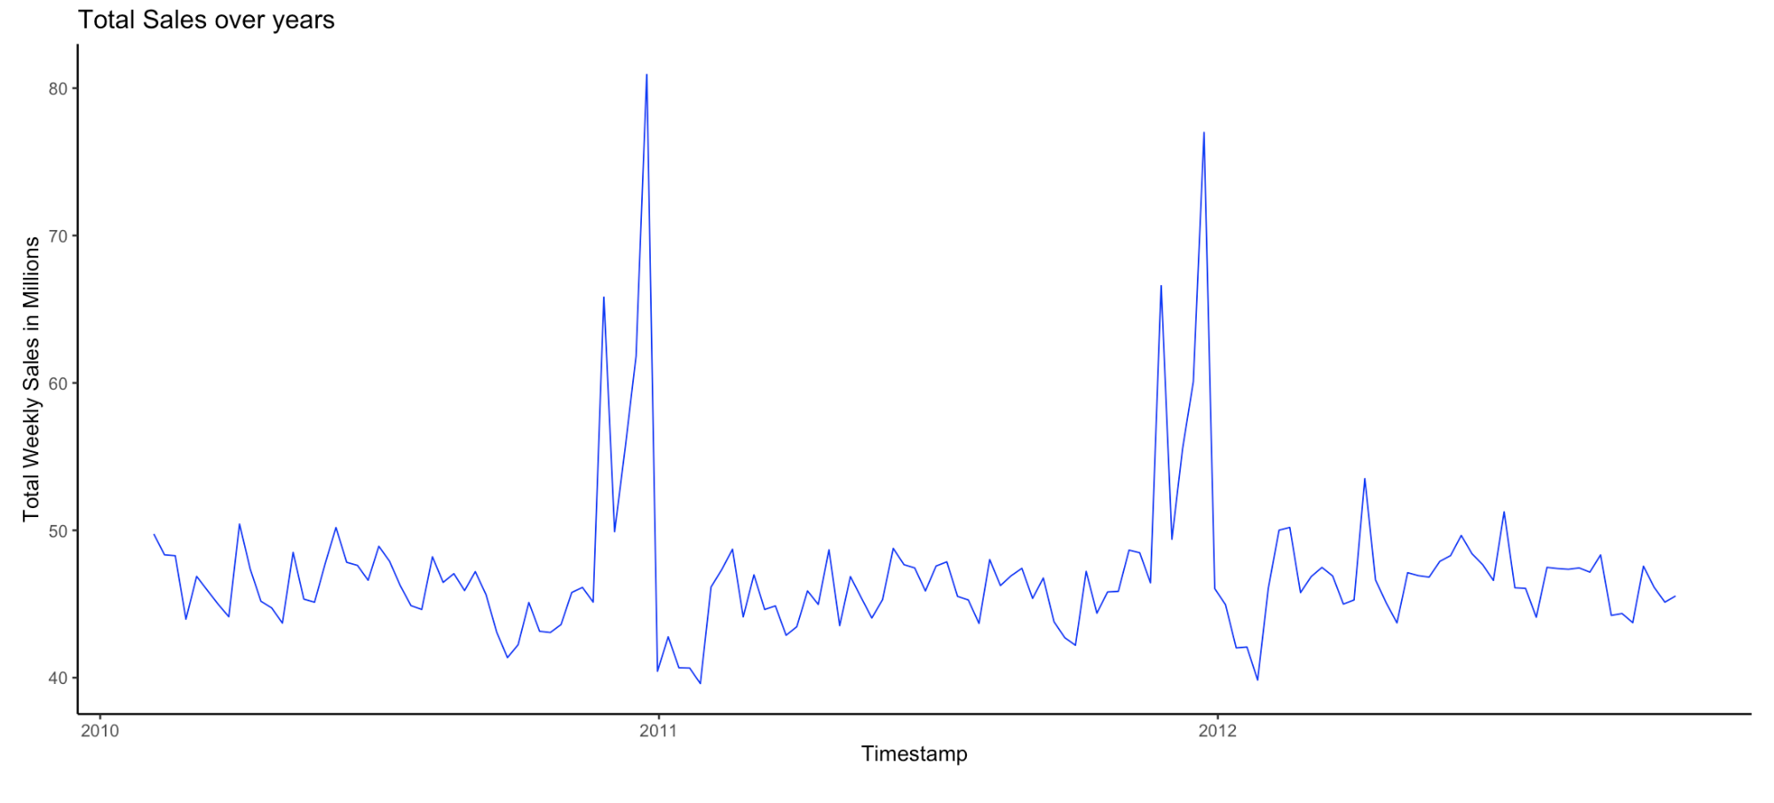
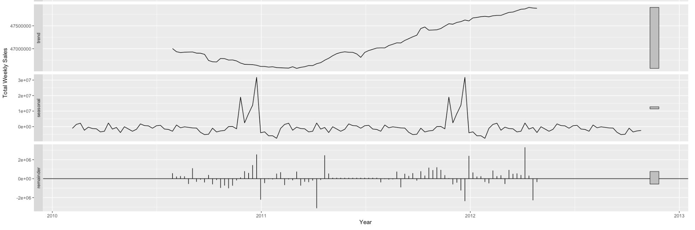
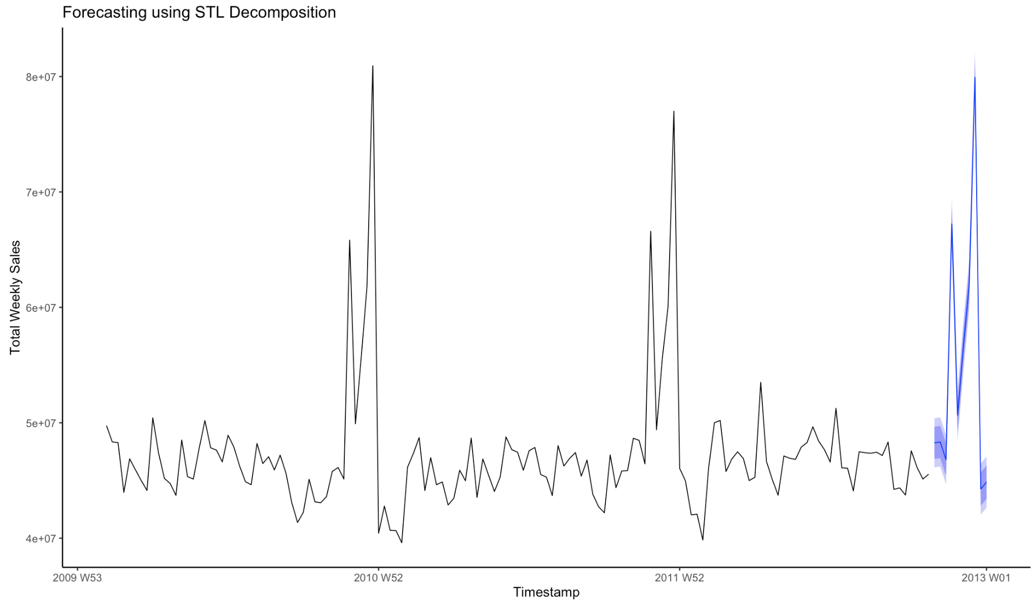
Decomposition But Why?
decompose
Original Dataset
Subtract
Trend, Seasonal
Add back the
Trend, Seasonal
Model
Forecast

Slide 19
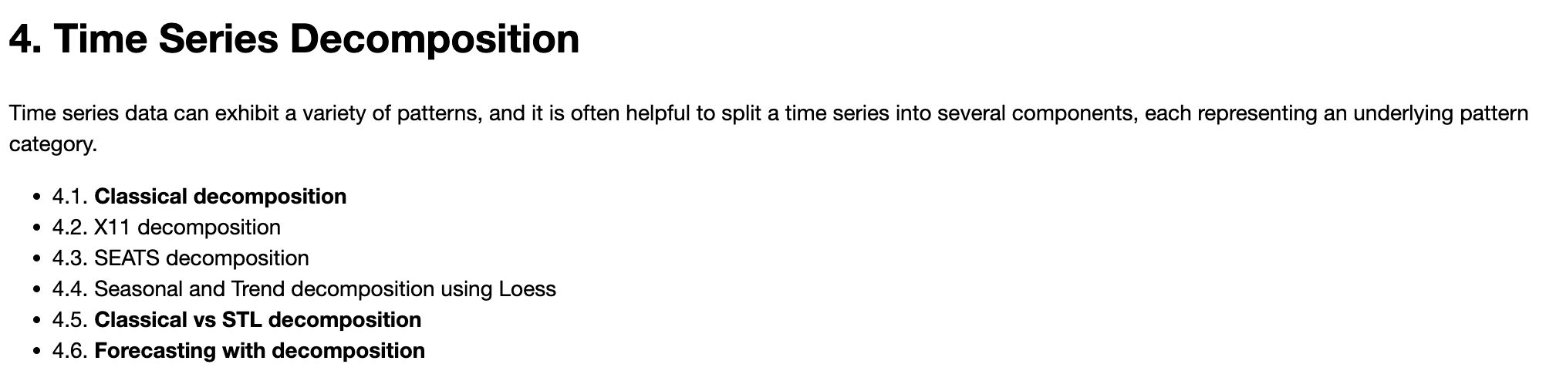
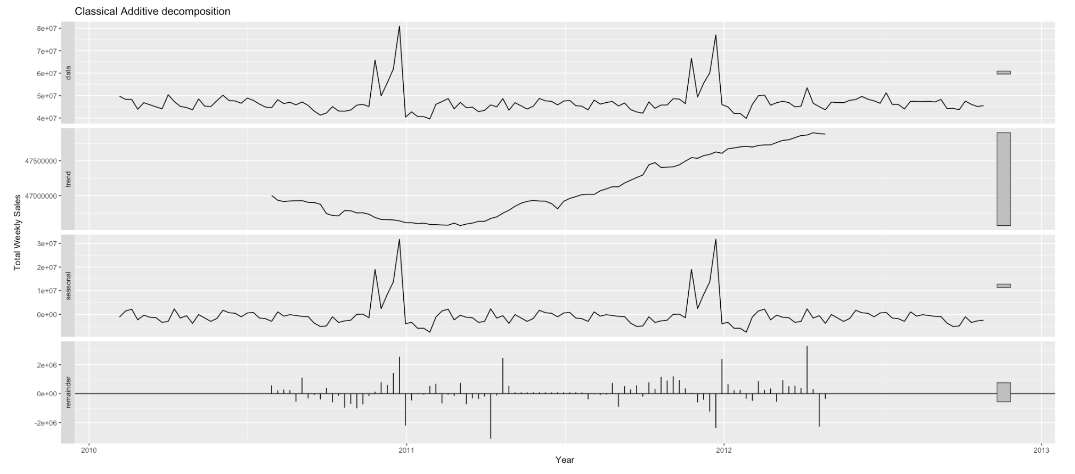
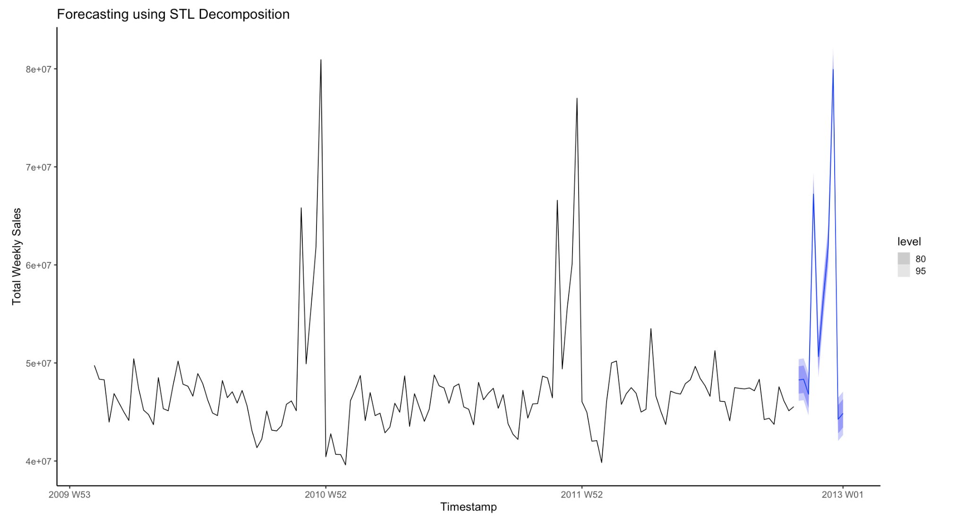
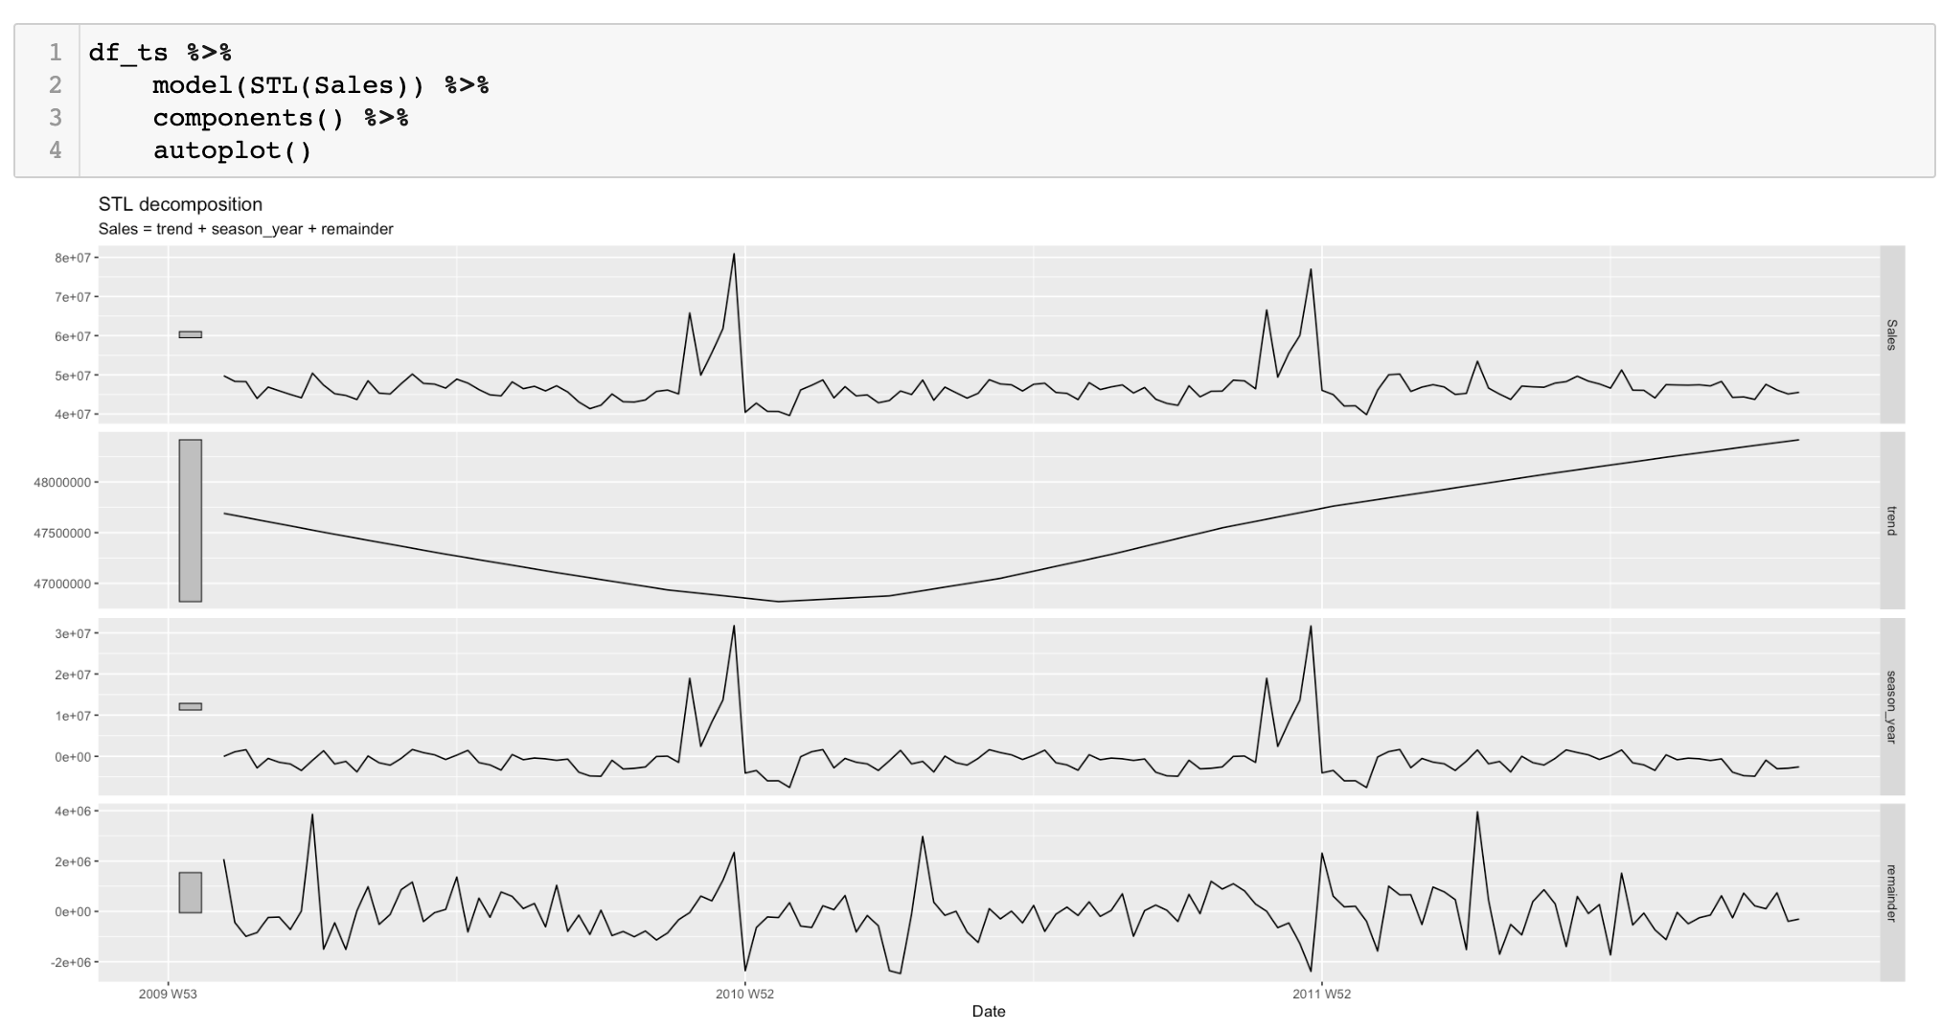
Time Series Decomposition

Slide 20
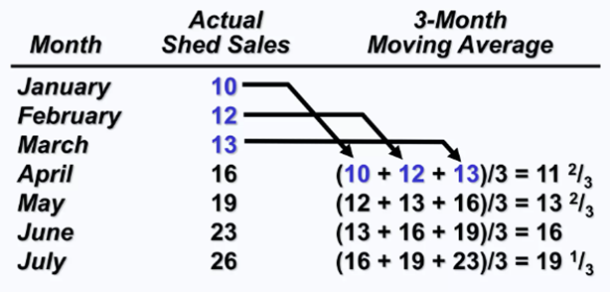
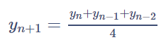
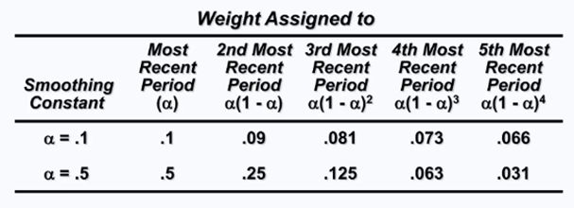
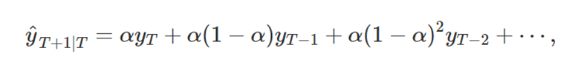
Moving Average & Exponential Smoothing
Naïve Method/ Moving Average:
Assumes Sales of next month will be equal to average sales of recent months.
Ex. If Sales of January is 40K and February is 42K then March will have 41K (average of last two months)
Exponential Smoothing
Form of Weighted moving average
Weights decline exponentially
Most Recent Data weighs most ex. For forecasting March sales: february sales will matter more than January and so on

Slide 21
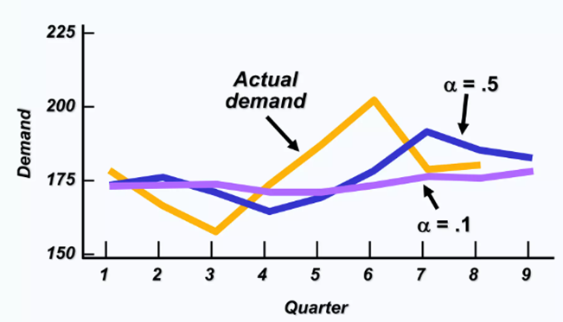
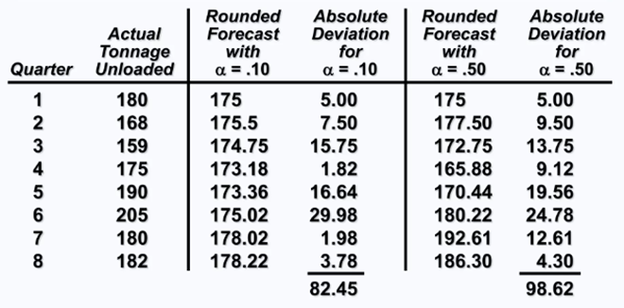
Exponential Smoothing
Impact of different alpha
Range from 0 to 1
Choose alpha that gives lowest forecast error
alpha value close to 1 :- More weightage to recent observation
alpha value close to 0 :- less weightage to recent observations

Slide 22
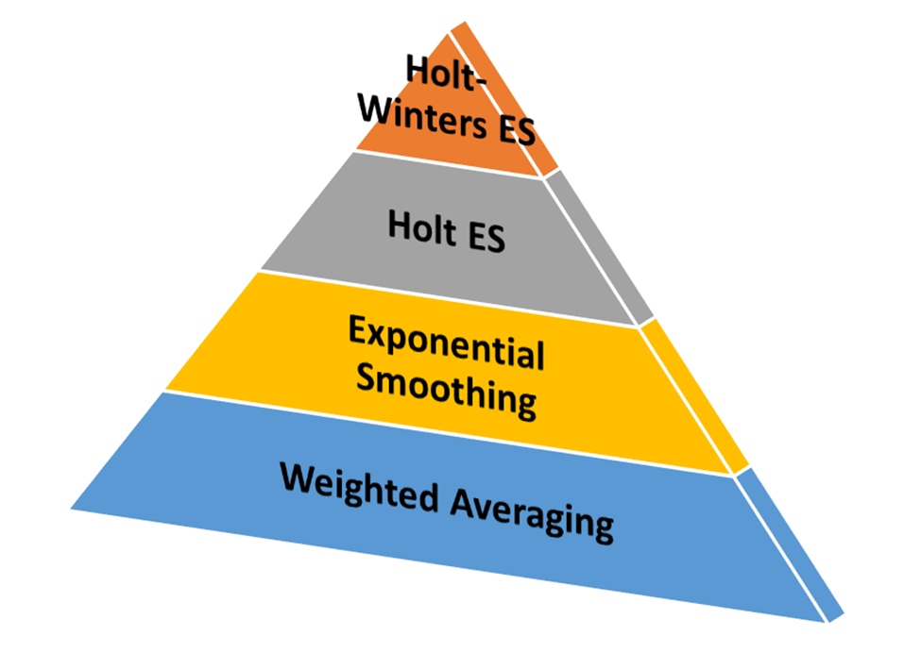
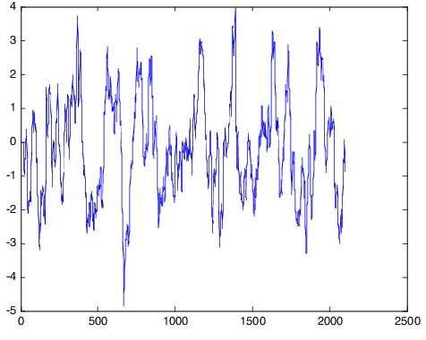
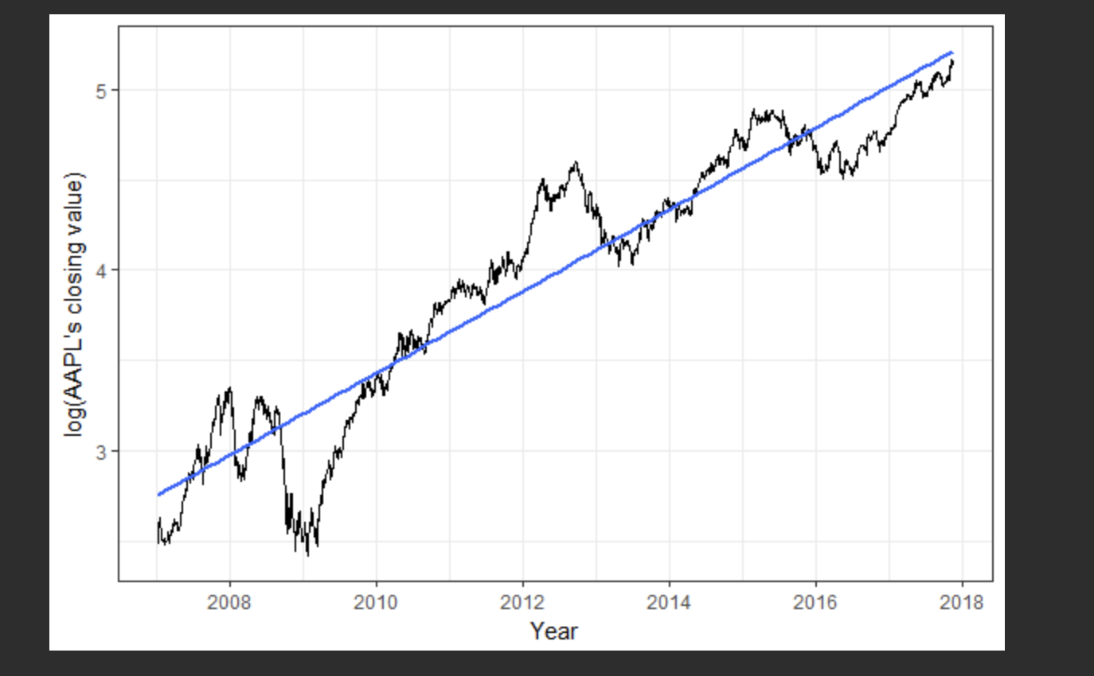
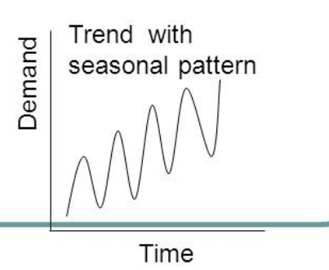
Exponential Smoothing Types
Three types based on Seasonality and Trend information
Simple Exponential Smoothing (SES)
Data has no Trend or Seasonality
Double Exponential Smoothing (DES)/ Holt ES
Data has trend but no seasonality
Extra Beta component for Trend
Triple Exponential Smoothing (TES)/ Holt-Winters ES
Data has both trend and seasonality
Extra Gamma component for Seasonality
No Trend or Seasonality
Linear Trend but no Seasonality
Both Linear Trend and Seasonality

Slide 23
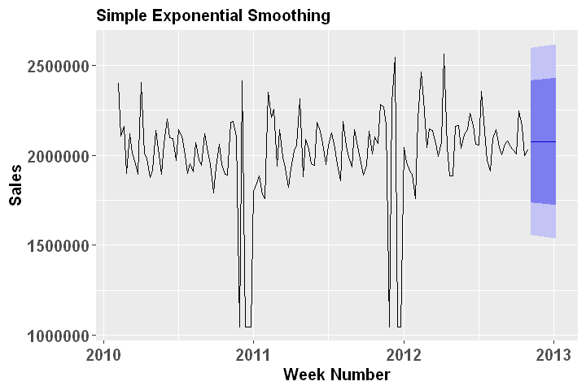
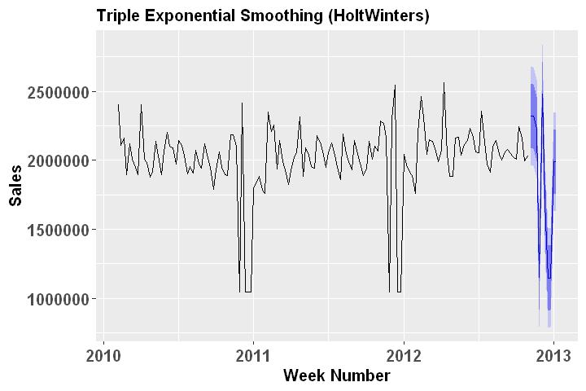
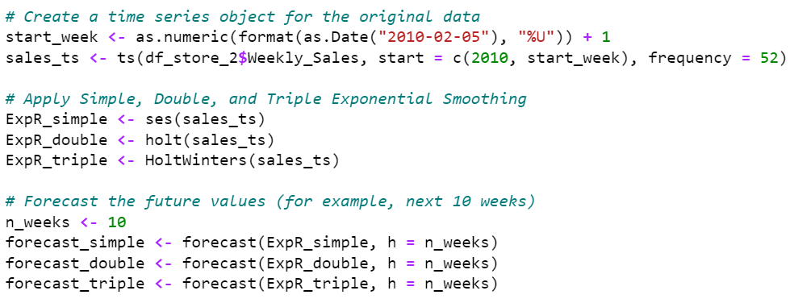
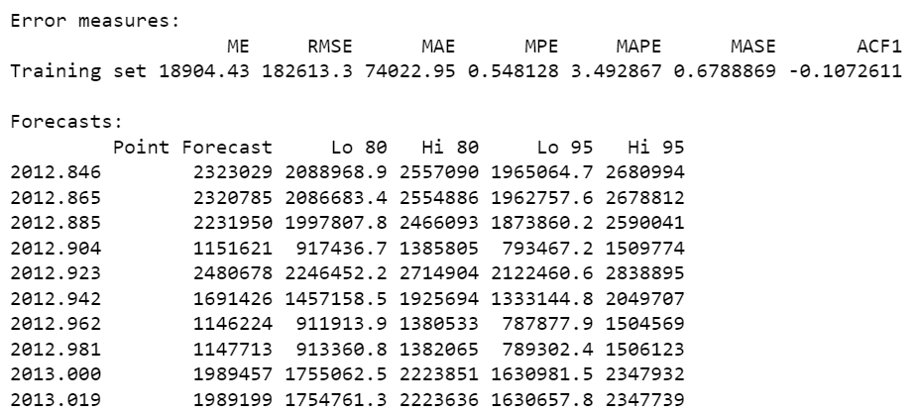
Exponential Smoothing for Walmart Sales

Slide 24
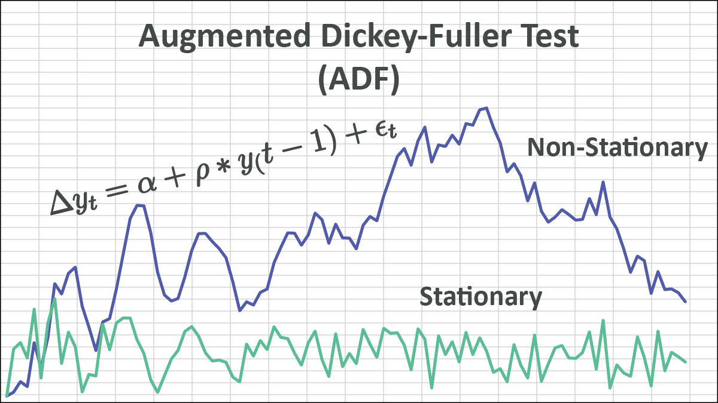
ARIMA Modelling
Time Series Analysis (ARIMA Modeling) Assessing the behavior/data-generating process of the time-series To understand the data-generating process in an overview, we can find correlations among different lags, before jumping further.
Why Time Series data needs to be Stationary?
Many time series modeling techniques, such as ARIMA, require the data to have constant statistical properties over time.
Stationarity implies that the mean, variance, and autocorrelation structure of the time series remain constant over time
If these properties change over time, then the modeling assumptions may be violated, and the resulting forecasts may be unreliable.
Techniques:
Augmented Dickey-Fuller (ADF) Test
Kwiatkowski-Phillips-Schmidt-Shin (KPSS) Test
Notes:
ARIMA - autoregressive integrated moving average
We checked for stationary:
all were stationary. if it wasn’t stationary then one way we can resolve this is by doing log transformation

Slide 25
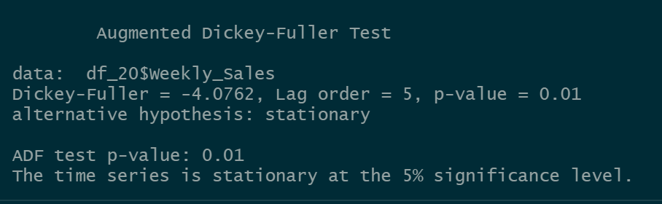
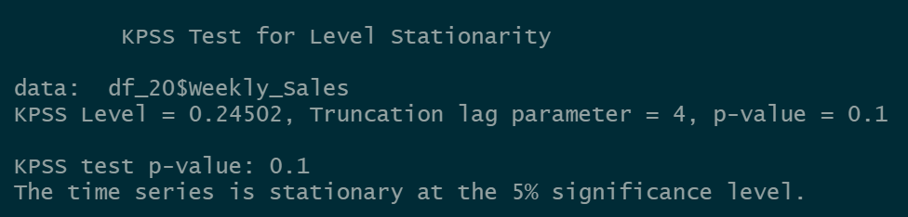
ARIMA Modelling
Augmented
Dickey-Fuller
(ADF)
Test
Kwiatkowski
Phillips
Schmidt
Shin (KPSS)
Test

Slide 26
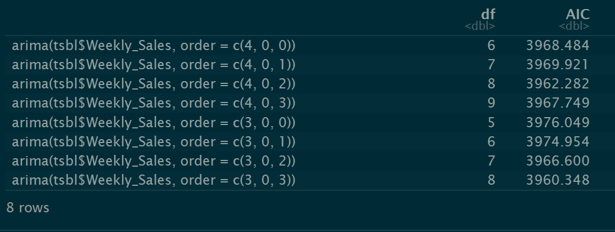
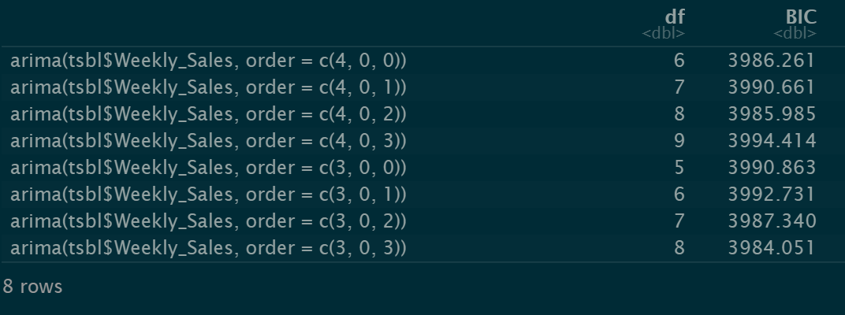
ARIMA Modelling
Parameters for ARIMA Modelling
An ARIMA model is defined by its three order parameters, p, d, q.
The Autoregressive (AR) terms capture the effect of the past values of the series on its current value.
The Moving Average (MA) terms capture the effect of the past errors (residuals) on the current value of the series.
The Integrated (I) term indicates the number of times the series needs to be differenced in order to achieve stationarity.
So for example, in ARIMA modeling, (3,0,1) represents the order of the model. Specifically, it indicates that the model includes 3 autoregressive (AR) terms, 0 integrated (I) terms, and 1 moving average (MA) term.
How to choose these parameters?
We did a comparison AIC and BIC values, based on this tests, best suggested ARIMA is ARIMA(3,0,3) or ARIMA(3,0,2)
Notes:
We checked for stationary:
all were stationary. if it wasnt stationary then one way we can resolve this is by doing log transformation
p specifies the number of Autoregressive terms in the model. d specifies the number of differentations applied on the time series values. q specifies the number of Moving Average terms in the model.

Slide 27
ARIMA Modelling
Parameters for ARIMA Modelling
An ARIMA model is defined by its three order parameters, p, d, q.
The Autoregressive (AR) terms capture the effect of the past values of the series on its current value.
The Moving Average (MA) terms capture the effect of the past errors (residuals) on the current value of the series.
The Integrated (I) term indicates the number of times the series needs to be differenced in order to achieve stationarity.
So for example, in ARIMA modeling, (3,0,1) represents the order of the model. Specifically, it indicates that the model includes 3 autoregressive (AR) terms, 0 integrated (I) terms, and 1 moving average (MA) term.
How to choose these parameters?
We did a comparison AIC and BIC values, based on this tests, best suggested ARIMA is ARIMA(3,0,3) or ARIMA(3,0,2)
Notes:
We checked for stationary:
all were stationary. if it wasnt stationary then one way we can resolve this is by doing log transformation
p specifies the number of Autoregressive terms in the model. d specifies the number of differentations applied on the time series values. q specifies the number of Moving Average terms in the model.

Slide 28
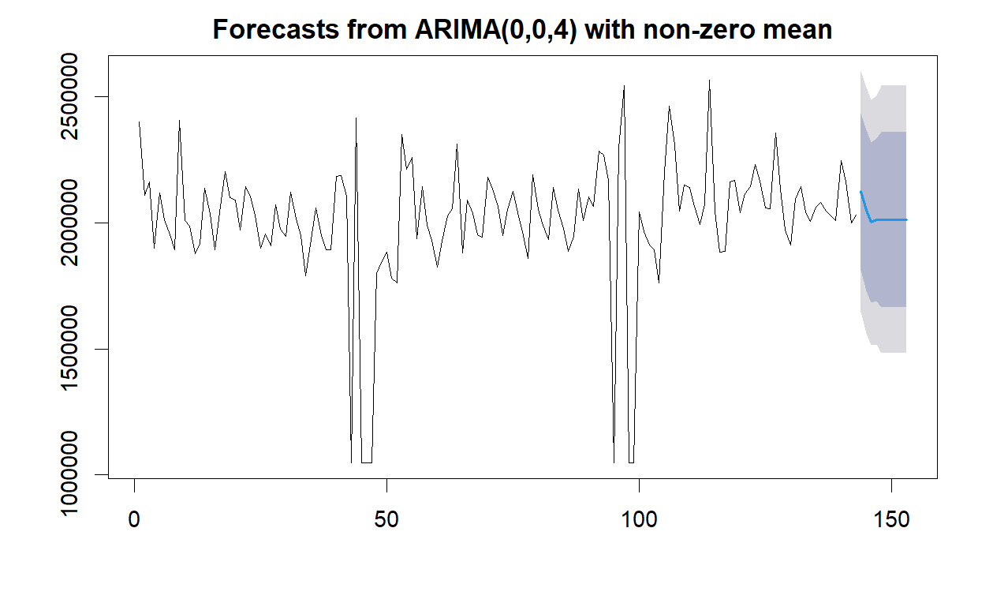
ARIMA Modelling
Auto-Arima
Returns Best ARIMA model according to either AIC, AICc or BIC value.
The function conducts a search over possible model within the order constraints provided

Slide 29
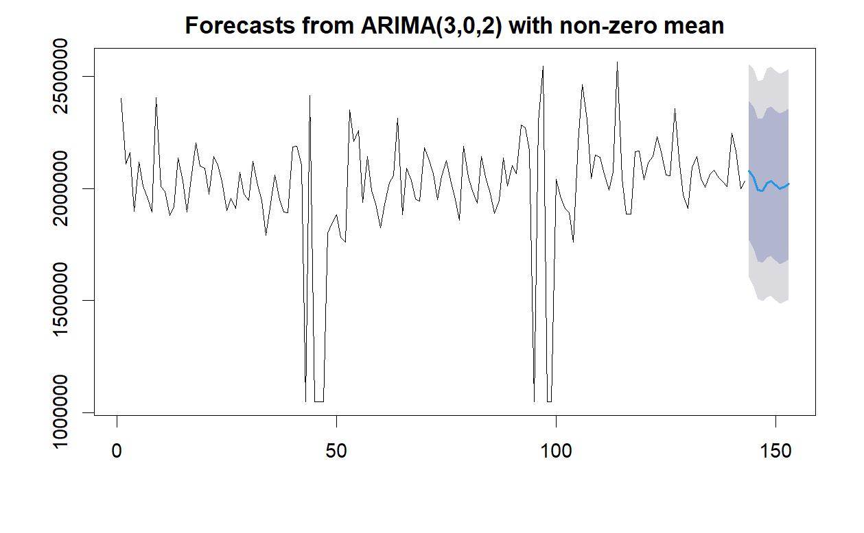
ARIMA Modelling
Our Arima Model
Model built by selecting
the right parameters
i.e. , p, d, q from
our analysis of AIC
and BIC.

Slide 30
ARIMA Modelling
Accuracy of our Model
RMSE is 92022.66, which means that on average, the forecasted values are off by around $92,022.66 from the actual values.
The Mean Absolute Percentage Error(MAPE) is 3.22, which means that on average, the forecasted values are off by around 3.22% from the actual values.
The Mean Absolute Scaled Error(MASE) is 0.35, which means that the forecast accuracy is 35% better than a naive forecast that simply uses the previous value as the forecast.
Notes:
ME: Mean Error, which is the average difference between the forecasted values and the actual values.
RMSE: Root Mean Squared Error, which is the square root of the average of the squared differences between the forecasted values and the actual values.
MAE: Mean Absolute Error, which is the average absolute difference between the forecasted values and the actual values.
MPE: Mean Percentage Error, which is the average percentage difference between the forecasted values and the actual values.
MAPE: Mean Absolute Percentage Error, which is the average absolute percentage difference between the forecasted values and the actual values.
MASE: Mean Absolute Scaled Error, which is a measure of forecast accuracy that adjusts for the scale of the time series.
ACF1: Autocorrelation of Errors, which measures the correlation between the forecast errors at different lags.

Slide 31




Meet Our Team
Pranjal Pathak
Akhilesh Patil
Data Gathering
Time Series Decomposition
Presentation
Data Gathering
Time Series Regression
Time Invested
Time Invested
Effort Estimate
Effort Estimate
Prasenjeet Gadhe
Nikhil Belavinakodige
Data gathering, Regression
Approach Planning
Exponential smoothing
Data Gathering, Data Cleaning
ARIMA
Time Invested
Time Invested
Effort Estimate
Effort Estimate

Slide 32

Thank you.

